Slide 1

A Deep Learning Based Two Stage Framework for Fine Grained Bangladesh Vehicle Recognition in Autonomous Driving

Slide 2
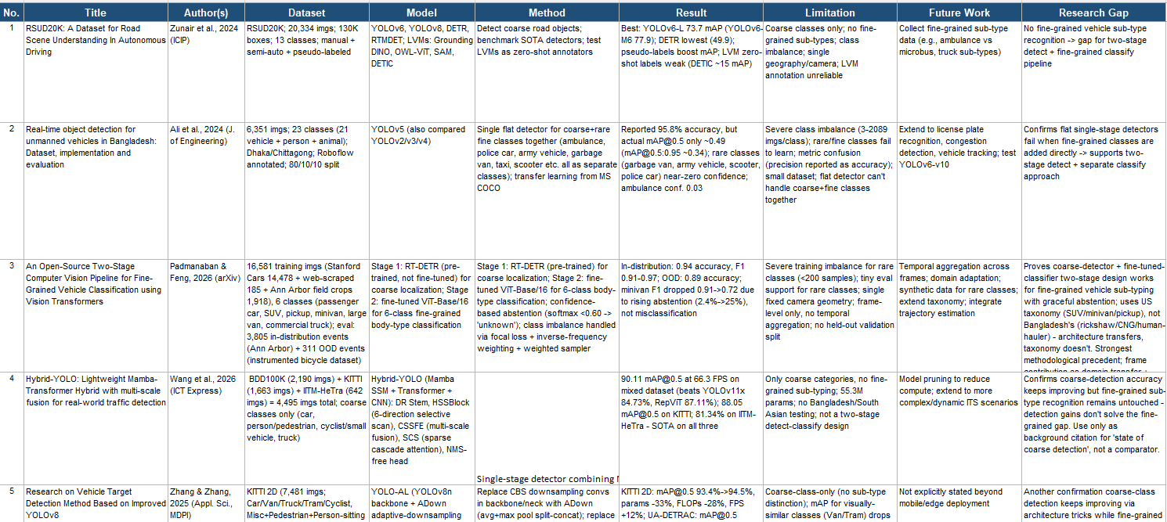
Related Papers:

Slide 3
The Research Gap
What the reviewed papers show is missing
✓
✕
★
Two-Stage Detection Works
Flat Models Fail Locally
Never Tested on Bangladesh
Proven for detecting, then classifying, US and European vehicle types
Miss rare, look-alike Bangladeshi vehicles
e.g. Rickshaw vs. Rickshaw-van
No local vehicle taxonomy tried this way, and no real dashcam video test
The Gap: A two-stage pipeline proven elsewhere has never been applied to Bangladesh’s own vehicles or verified on real-world dashcam video.

Slide 4
The Research Question
What this study sets out to answer
“
Does a two-step “detect, then classify” approach recognize Bangladesh’s look-alike local vehicles better than a single all in one model and does that hold up on real dashcam video?
Sub-Questions
Which model backbone works best?
Two-stage vs. one-stage: which wins?
Does it hold up on real video?

Slide 5
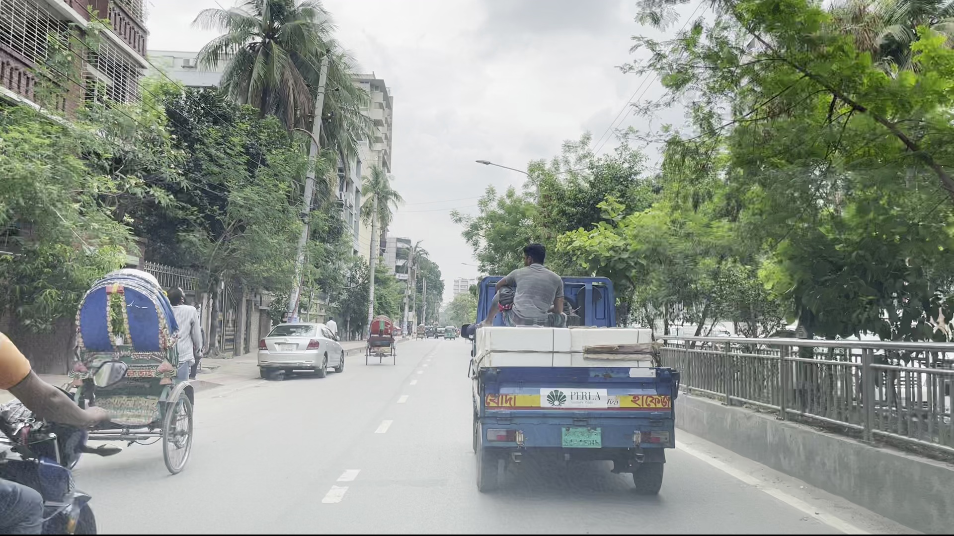
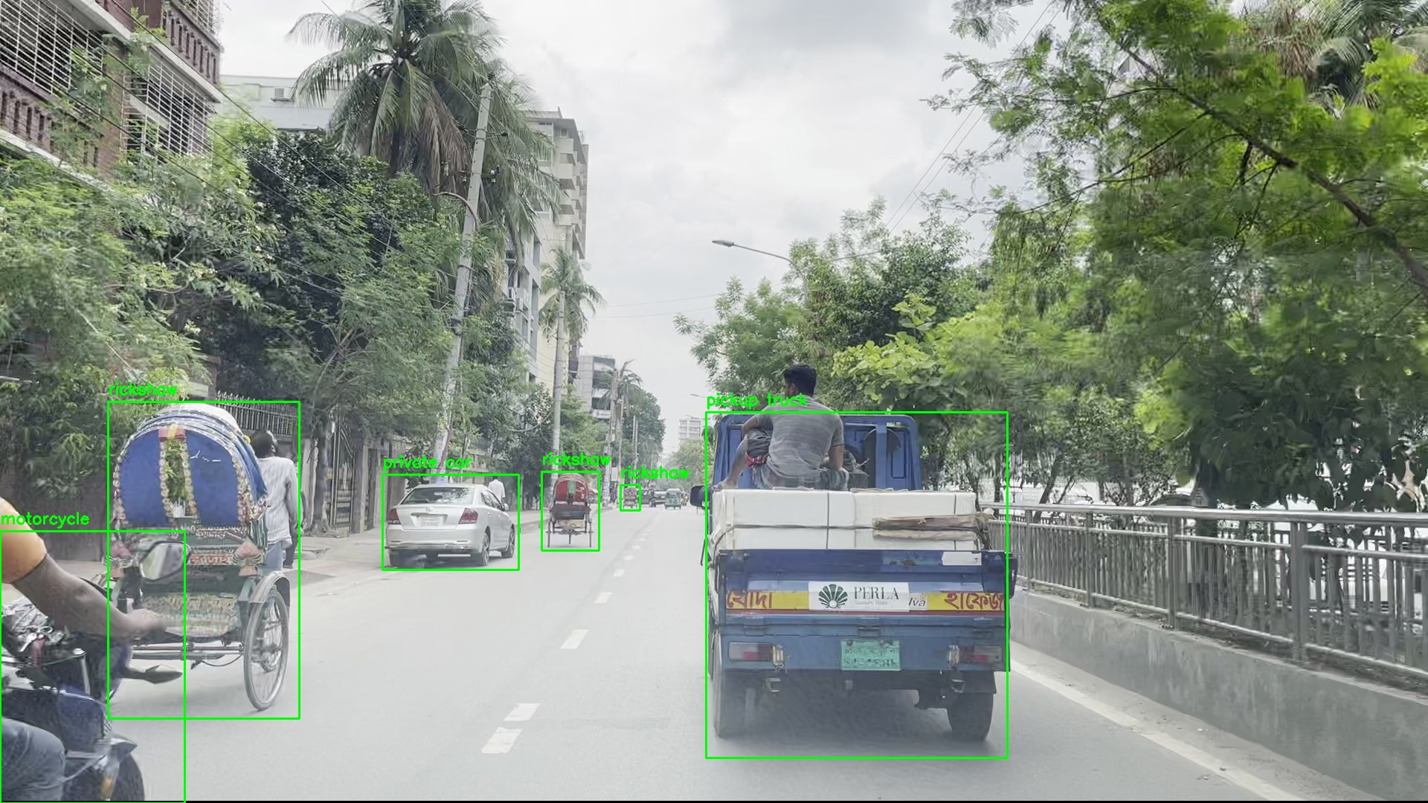
Original Dataset (RSUD20K)
The original dataset made for YOLO
20,334 road scene images captured on Bangladesh roads.
Dataset split: Train (18,681), Validation (1,004), Test (649).
13 annotated object classes with approximately 130,000 YOLO bounding boxes.
Directory structure: Images, YOLO label, Classes
Designed for object detection in autonomous driving applications.

Slide 6
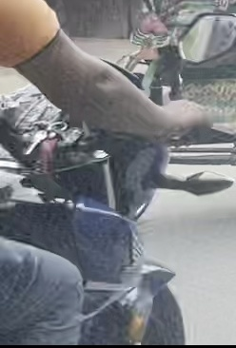
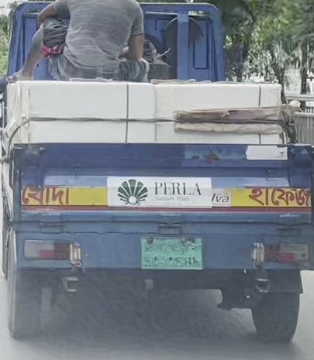
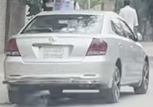

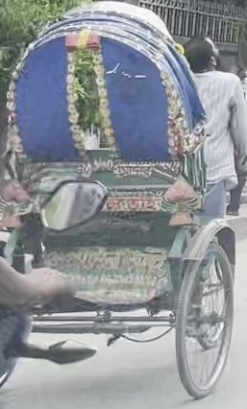
Proposed Classification Dataset
New Dataset made for CNN training
Created by cropping objects using RSUD20K YOLO annotations.
130,000 cropped images across 13 road object classes
Dataset split: Train (118,810), Validation (7,385), Test (3,805).
Original Train/Validation/Test split preserved
Images organized into class-wise folders for CNN training.

Slide 7
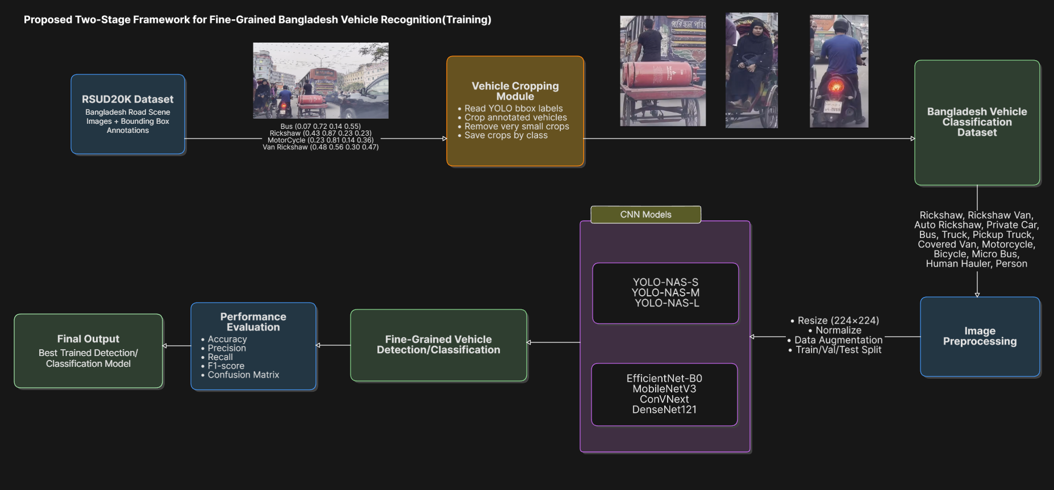
Two-Stage Framework Architecture
System diagram illustrating the proposed recognition pipeline
Fig 1: Training pipeline

Slide 8
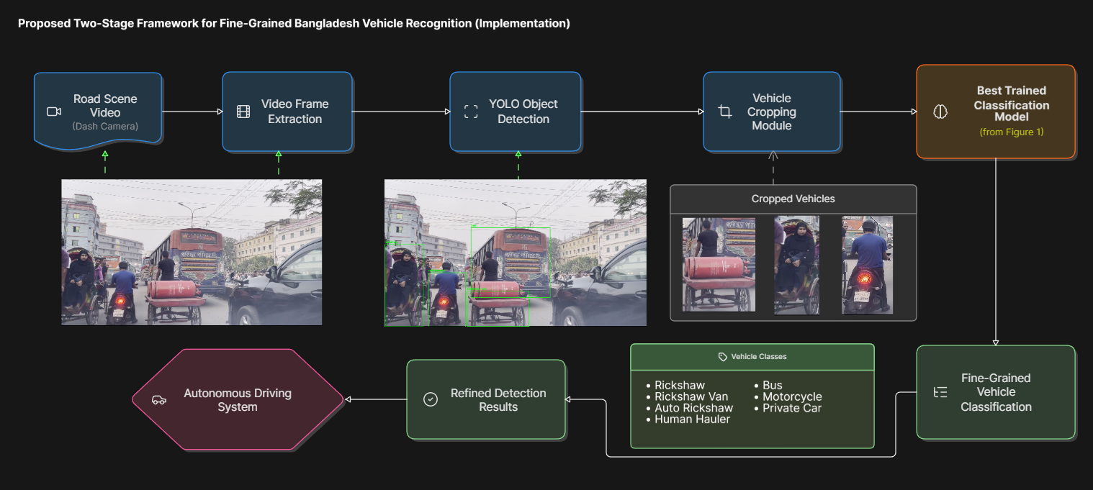
Two-Stage Framework Architecture
System diagram illustrating the proposed recognition pipeline
Fig 2: Implementation pipeline

Slide 9
Conclusion
Summary of the proposed contribution
✓
✓
★
A Purpose-Built Dataset
A Direct Two-Stage Test
Closing a Documented Gap
RSUD20K's ~130,000 annotated boxes cropped into a dedicated Bangladesh vehicle classification dataset across 13 classes
Two stage detection benchmarked and compared against single-stage detection
Directly extends RSUD20K's own stated future work on fine-grained sub-type recognition
In Summary: This work applies a two stage detect then classify pipeline, proven elsewhere, to Bangladesh's own vehicle taxonomy for the first time directly testing it against single stage detection on the same data.

Slide 10


